Slide 1
King Saud University
College of Computer & Information Sciences
Computer Science Department
CSC380
Introduction to Database Systems
(Microsoft Access)

Slide 2
Outline
Introduction
Some Advantages
Some Disadvantages
Example (Demo Library Database)
https://www.wikihow.com/Make-a-Database-Using-MS-Access
Microsoft Access
1

Slide 3
Introduction
Microsoft Access is a powerful program to create and manage small
database applications.
Microsoft Access is an optimal database design system for specific
environments.
Microsoft Access
2

Slide 4
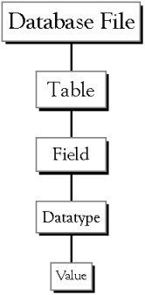
The Hierarchy that MS Access Uses in breaking down a database
Database File: the main file that encompasses
the entire database.
Table: a collection of data about a specific
topic
Fields: different categories within a table.
Datatypes: properties of each field.
Microsoft Access
3

Slide 5
Some Advantages
Easy to use:
  Provides tools which can be mastered by the most inexperienced
  database users.
  Quick development.
Data migration:
  Sharing and moving data is very easy (single file system).
Simple backups/archiving:
  Only one single file should be backed up.
Microsoft Access
4

Slide 6
Some Disadvantages
Limited to small databases:
  Low capacity database system.
  (2 gigabyte file size limit for the entire database)
  Designed to efficiently manage relatively small number of
  database records.
Limited to low transaction rates:
  Not a good choice for high data entry environment.
Limited to low concurrent database usage:
  Microsoft Access runs best as a single-user system or a small
  multi-user system.
Microsoft Access
5

Slide 7
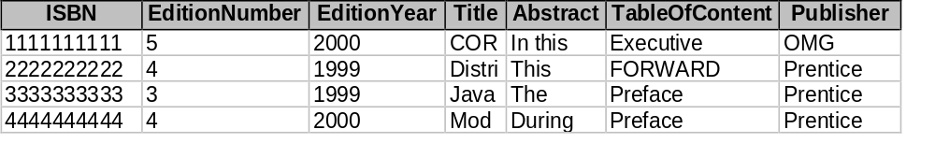

Example (Demo Library Database)
Book table:
Author table:
Microsoft Access
6

Slide 8
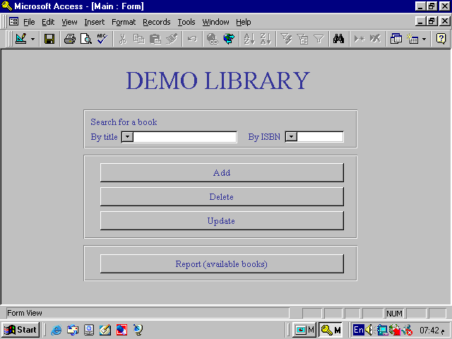
Example (Demo Library Database)
Microsoft Access
7

Slide 9
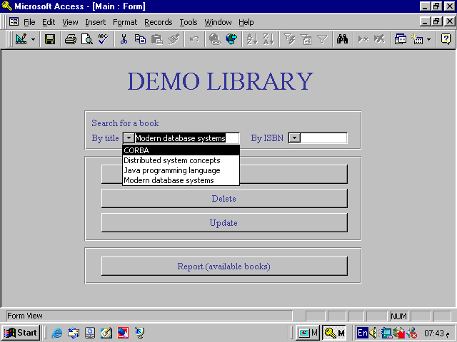
Example (Demo Library Database)
Microsoft Access
8

Slide 10
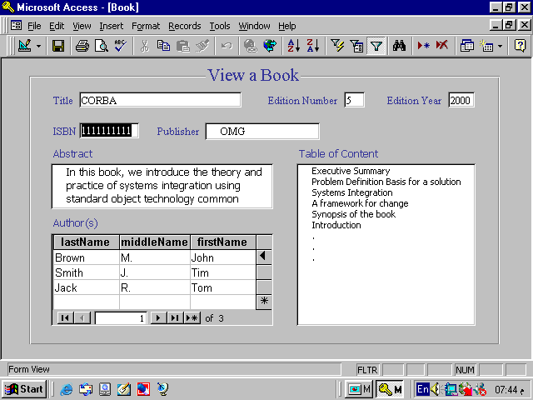
Example (Demo Library Database)
Microsoft Access
9

Slide 11
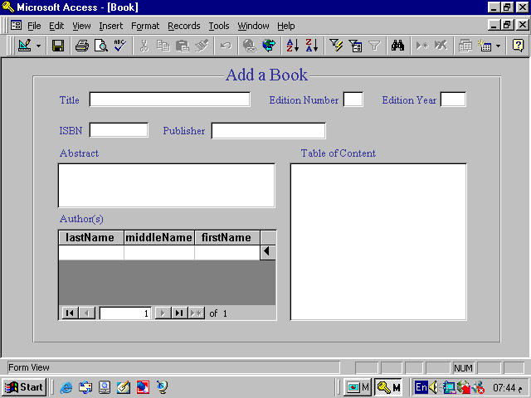
Example (Demo Library Database)
Microsoft Access
10

Slide 12
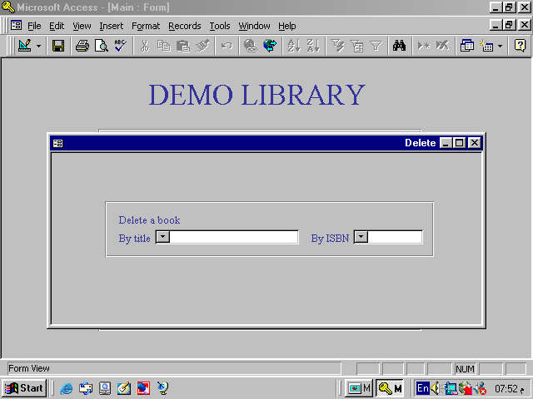
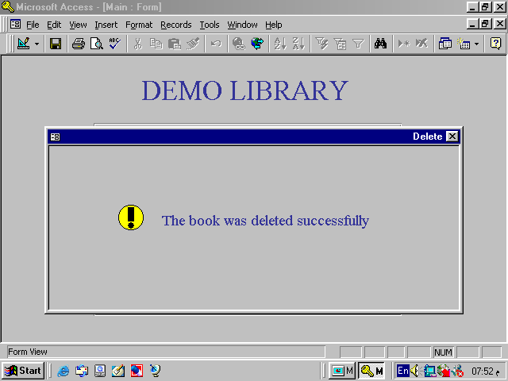
Example (Demo Library Database)
Microsoft Access
11

Slide 13
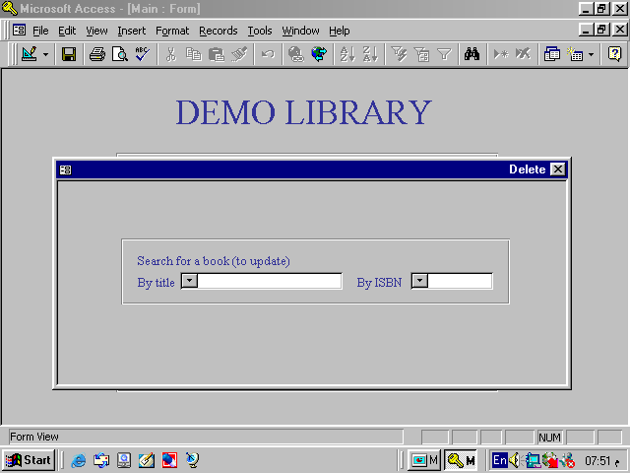
Example (Demo Library Database)
Microsoft Access
12

Slide 14
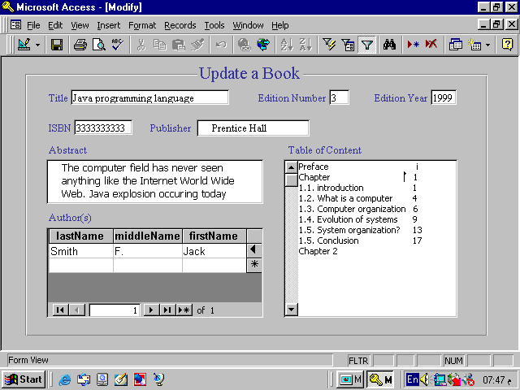
Example (Demo Library Database)
Microsoft Access
13

Slide 15
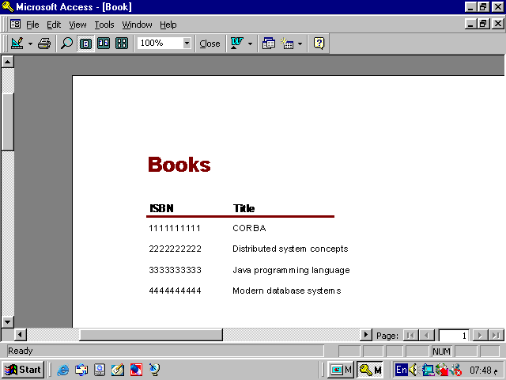
Example (Demo Library Database)
Microsoft Access
14

